Slide 1

An Introduction to the frontend

Slide 2
Why do we need Frontend ?
Front-end development can help make the user journey across a website much simpler, easier, and more convenient.
Frontend development contributes to the overall user experience by creating interfaces that are intuitive, responsive, and engaging.
With the proliferation of devices and screen sizes, frontend development ensures that websites and applications work seamlessly across different platforms and devices.
The frontend is often the first point of contact between users and a brand. Frontend development allows designers to create visually appealing interfaces that reflect the brand's identity, values, and messaging.

Slide 3
Connection with the backend

Slide 4
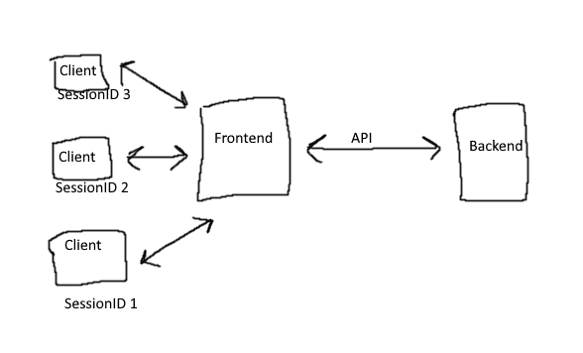
How data is transferred between frontend and backend ?
Data transfer between the frontend and backend typically involves communication over the internet using various protocols and technologies.
Client-Server Architecture
HTTP Protocol
URLs and Endpoints
APIs (Application Programming Interfaces)

Slide 5
Let’s Start
Perquisite: You have Node.js installed on your system

Slide 6


How to install ReactJs ?
What is the difference between Create React app and Vit.js ?
Magic Command:
$$\text{npm} \text{create} \text{vite}\text{@}\text{latest}$$

Slide 7
What is component?
Perquisite: You have created your react Application.

Slide 8
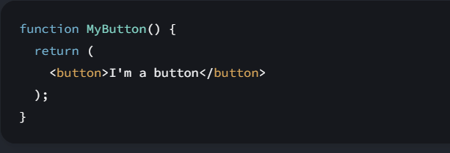
Components :
React apps are made out of components. A component is a piece of the UI (user interface) that has its own logic and appearance. A component can be as small as a button, or as large as an entire page.
Whenever a component is made it should always start with capital letter.

Slide 9
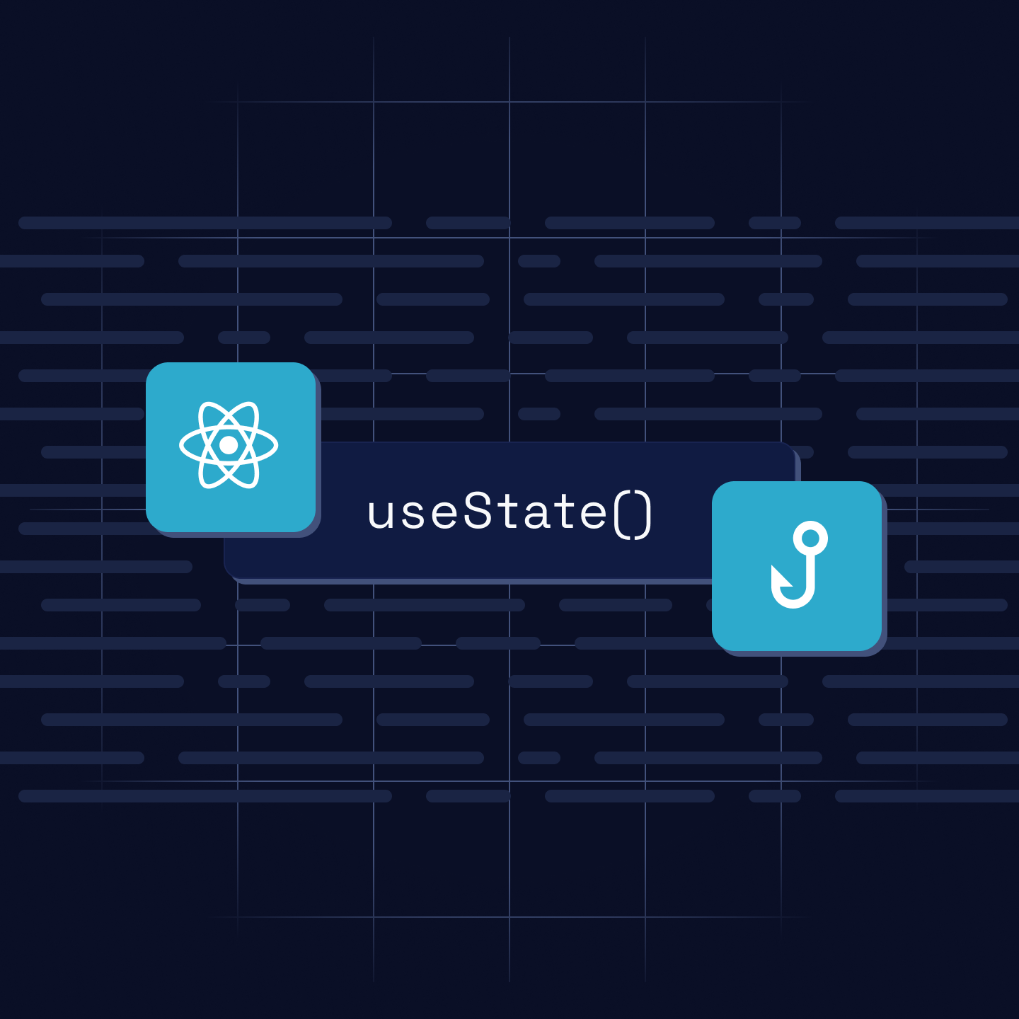
UseState:
This React Hook lets us add a state variable to your component which returns an array with exactly two values.
Current State
Set Function

Slide 10
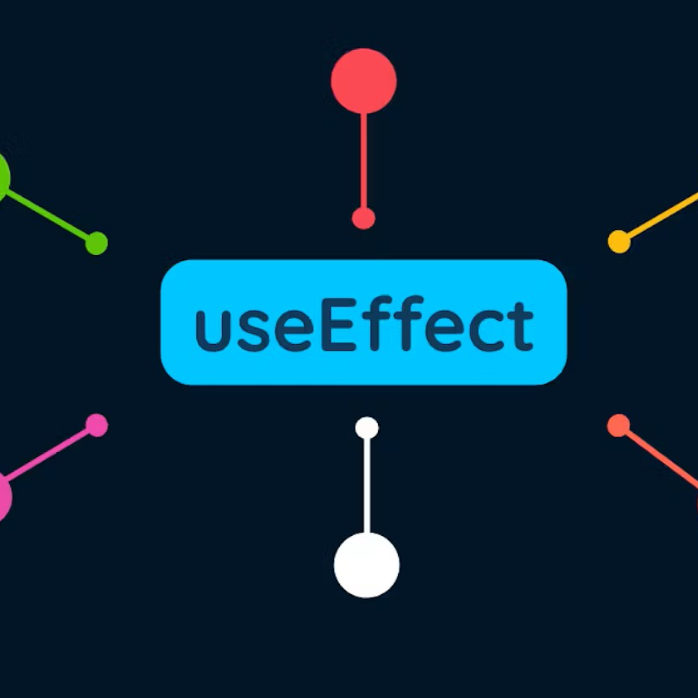
Useeffect:
It is a react hook that lets you perform side-effects in the component.
Side effects basically is an action which connects the component to the outside world.

Slide 11
What now after this ?

Slide 12
Thank you

